Slide 1

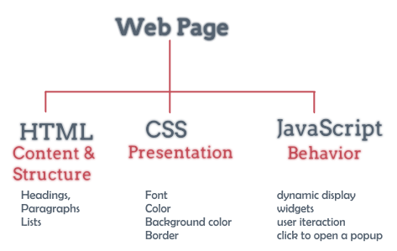
XML and DOM model

Slide 2
Lesson Objectives
Understanding HTML DOM in web design
Grasp the preeminent features of HTML DOM combined with JavaScript
Applying the dynamics of HTML DOM in designing and building websites
Understand and analyze XML document structure
Understand how AJAX works in data retrieval

Slide 3
Lesson content
Introduction to HTML DOM
Properties and Method in DOM
Handling events in DOM
Introduction to XML
Elements of XML
Introducing AJAX

Slide 4
1. Introduction to HTML DOM
HTML DOM = HTML Document Object Model
Website as a tree of many nodes
Each button is an element (HTML tag, attribute, content of tag)
DOM is a W3C standard

Slide 5
1. Introduction to HTML DOM
<html> <head> <title>DOM Tutorial</title> </head> <body> <h1>DOM Lesson one</h1> <p>Hello world!</p> </body> </html>
Root <html>
All remaining nodes in the DOM are contained in <html>
The <html> node has two child nodes, <head> and <body>
The <head> node contains the <title> node
The <body> node contains the <p> node

Slide 6

1. Introduction to HTML DOM
DOM tree

Slide 7
1. Introduction to HTML DOM
Parents, Children, and Siblings node
The nodes in the tree have a hierarchical relationship.
Parent has multiple children nodes
Same level with children is called sibling node
Some notes in the HTML DOM tree:
The top node is called the root node.
All nodes except the root node have only one parent node.
A node has many children
The level with the child node is the sibling node
Leaf node has no child node

Slide 8
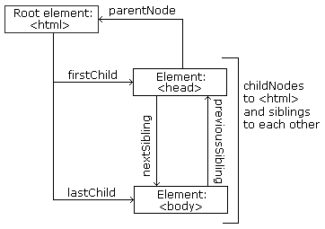
1. Introduction to HTML DOM
Parents, Children, and Siblings

Slide 9
1. Introduction to HTML DOM
Parents, Children, and Siblings
Explanation
The root node is <html> with no parent node
The parent node of the <head>, and <body> is the <html> node
The parent node of the “Hello world” node is the <p> node
And
The <html> node has 2 child nodes: <head>, <body>
The <head> node has a child node: <title>
The <title> node has a child node “DOM Tutorial”
Node <h1> and <p> are two sibling nodes, both are child nodes of <body> node
<html> <head> <title>DOM Tutorial</title> </head> <body> <h1>DOM Lesson one</h1> <p>Hello world!</p> </body> </html>

Slide 10
2. DOM Properties and Methods
Some Methods of document:
document.createElement(“tag”): create an element
document.getElementById(“id”): find an element by ID
document.getElementsByTagName(“tag”): find elements by tag
document.getElementsByClassName(“class”): find elements by class

Slide 11
2. DOM Properties and Methods
Some properties of Element:
x.id – id of x
x.tagName – tag name of x
x.innerHTML – text value of x (as HTML)
x.parentNode – parent node of x
x.childNodes – child nodes of x
x.attributes – attributes of x
x.className – class name of x

Slide 12
2. DOM Properties and Methods
Some methods of Element:
x.getElementsByClassName(“class”): find elements by class
x.getElementsByTagName(“name”): find elements by tag name
x.querySelector(“selectors”): find elements by css selector
x.appendChild(node): add child node to x
x.removeChild(node): delete child node from x
x.setAttribute(“attr”, “value”): assign attribute value to x

Slide 13
2. DOM Properties and Methods
Properties
-Get the value of <p> tag with id="intro"
<body>
<p id="intro">Hello World!</p>
<script type="text/javascript">
txt=document.getElementById("intro").innerHTML;
document.write("<p>The text from the intro paragraph: " + txt + "</p>");
</script>
</body>
innerHTML
Used to access or change the content and format of HTML tags including <html> and <body> tags
In the example below: getElementById is the method, innerHTML is the property (attribute)➔.

Slide 14
2. DOM Properties and Methods
Properties
-Get the value of <p> tag with id="intro"
<body> <p id="intro">Hello World!</p> <script type="text/javascript"> txt=document.getElementById("intro").childNodes[0].nodeValue; document.write("<p>The text from the intro paragraph: " + txt + "</p>"); </script> </body>
childNodes vs nodeValue
Used to get the contents of the tags
In the example below: getElementById is the method, childNodes and nodeValue are properties ➔

Slide 15
2. DOM Properties and Methods
And many objects in the DOM, refer to :
https://www.w3schools.com/jsref/dom_obj_document.asp
https://www.w3schools.com/jsref/dom_obj_all.asp
https://www.w3schools.com/jsref/dom_obj_attributes.asp
https://www.w3schools.com/jsref/dom_obj_event.asp
https://www.w3schools.com/jsref/dom_obj_style.asp

Slide 16
2. DOM Properties and Methods
Methods
getElementById()
Used to retrieve the node (tag) with the parameter id of that node
Syntax:
node.getElementById("id")
Example:
document.getElementById("intro");

Slide 17
2. DOM Properties and Methods
Example:
<body>
<p id="intro">Hello World!</p>
<script type="text/javascript">
x=document.getElementById("intro"); //get node x whose id is intro
document.write("<p>The text from the intro paragraph: " + x.innerHTML + "</p>"); //print the value of node x to the browser //using the innerHTML property
</script>
</body>

Slide 18
2. DOM Properties and Methods
Methods
getElementsByTagName()
Used to retrieve the node (tag) with the same tag name
Syntax:
node.getElementsByTagName("tagname");
Example:
document.getElementsByTagName("p");
→ Retrieve all tags named <p> ➔list of <p> tag

Slide 19
2. DOM Properties and Methods
Example:
<body>
<p>Hello World!</p>
<p>The DOM is very useful!</p>
<p>This example demonstrates the <b>getElementsByTagName</b> method.</p>
<script type="text/javascript">
x=document.getElementsByTagName("p"); //get all tags named p
document.write("Text of first paragraph: " + x[0].innerHTML); // Print to //the browser the value of the first tag
</script>
</body>

Slide 20
2. DOM Properties and Methods
getElementsByTagName() returns a list of tags with the same name:
Example:
x=document.getElementsByTagName("p");
Some of the features in this list are:
The first position is 0
To access each element in the list, for example, if we want to access the first element, we use:
y = x[1];
To get the length of a list, we use the length property

Slide 21
2. DOM Properties and Methods
Example:
<body>
<p>Hello World!</p>
<p>The DOM is very useful!</p>
<p>This example demonstrates the length property.</p>
<script type="text/javascript">
x=document.getElementsByTagName("p"); for (i=0;i<x.length;i++) { document.write(x[i].innerHTML); document.write("<br />"); }
</script>
</body>

Slide 22
3. Event handling in DOM
It is possible to change the content or attributes of an HTML tag when an event occurs
The event occurs when the user interacts with an object in the browser, when a page is reloaded, or when a form is submitted.

Slide 23
3. Event handling in DOM
<html> <head> <script type="text/javascript"> function ChangeText() { document.getElementById("p1").innerHTML="New text!"; } </script> </head> <body> <p id="p1">Hello world!</p> <input type="button" onclick="ChangeText()" value="Change text" /> </body> </html>
Onclick➔press mouse
Example 1:
Change the text of a tag when an event occurs by writing a function and then attaching that function to the onclick event
For example, we build the ChangeText() function in JavaScript language

Slide 24
3. Event handling in DOM
<html> <body> <input type="button" onclick="document.body.style.backgroundColor='lavender';" value="Change background color" /> </body> </html>
onclick→press mouse:
Example 2:
The onclick event is fired when the user clicks on the object on the form
The example below changes the background color of the <body> tag when the button is clicked

Slide 25
3. Event handling in DOM
<html> <head> <script type="text/javascript"> function ChangeStyle() { document.getElementById("p1").style.color="blue"; document.getElementById("p1").style.fontFamily="Arial"; } </script> </head> <body> <p id="p1">Hello world!</p> <input type="button" onclick="ChangeStyle()" value="Change style" /> </body> </html>
onclick→press mouse
Example 3:
Change the color and font of an HTML tag using functions.
The example below changes the color and font of the content of the <p> tag

Slide 26
3. Event handling in DOM
Some popular events
Most of the tags on the page contain events
A mouse click
A web page or an image loading
Mousing over a hot spot on the web page
Selecting an input box in an HTML form
Submitting an HTML form
A keystroke
Note: a page event is usually associated with a function, which only executes when the event occurs
Refer to the address: http://www.w3schools.com/jsref/dom_obj_event.asp

Slide 27
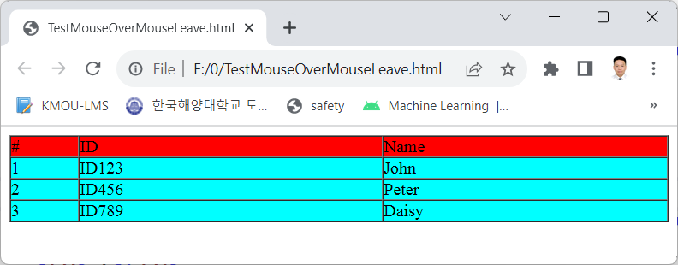
3. Event handling in DOM
Write coding to move the mouse on any row in the Table, then fill that line with yellow, move the mouse out, then fill it with cyan.

Slide 28
3. Event handling in DOM
<head>
<meta charset="utf-8" />
<title></title>
<script>
function changeYellow(tr)
{
tr.style.backgroundColor = "yellow"
}
function changeCyan(tr)
{
tr.style.backgroundColor = "cyan"
}
</script>
</head>

Slide 29
3. Event handling in DOM
<body>
<table border="1" style="width:100%" cellpadding="0" cellspacing="0">
<tr style="background-color:red">
<td>#</td>
<td>ID</td>
<td>Name</td>
</tr>
<tr style="background-color:cyan"
onmouseover="changeYellow(this)" onmouseout="changeCyan(this)">
<td>1</td>
<td>ID123</td>
<td>John</td>
</tr>
…
</table>
</body>

Slide 30
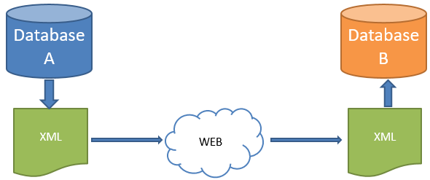
4. Introduction to XML
XML = EXtensible Markup Language
XML is a markup language like HTML
Used to store data
Users create their own tags
Comparison with HTML
HTML: display data
XML: storing and exchanging data
XML is used a lot in storing data as well as configuration files, used in parallel with JSon.

Slide 31
4. Introduction to XML
XML example file:
<student>
<id>999</id>
<name>John</ name>
<birthday>7/7/1997</birthday>
<gender>man</gender>
</student>

Slide 32
4. Introduction to XML
Advantages of XML:
Separate data from display (HTML)
Simplify data sharing on the web
Simplify data transfer between multiple platforms
Can expand data quickly

Slide 33
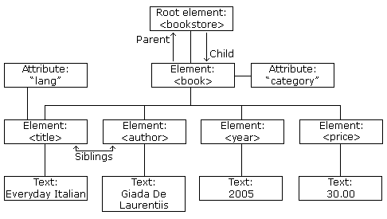
4. Introduction to XML
Example XML Tree Structure
<bookstore> <book category="COOKING"> <title lang="en">Everyday Italian</title> <author>Giada De Laurentiis</author> <year>2005</year> <price>30.00</price> </book>
</bookstore>

Slide 34
4. Introduction to XML
Important Notes:
Opening tags must have a corresponding closing tag
tag names are case sensitive
XML document must have a root tag
Attribute values must be enclosed in double (or single) quotes.
Comment
<!-- This is a comment -->

Slide 35
4. Introduction to XML
Special characters:
Character | Meaning
&lt; | <
&gt; | >
&amp; | &
&apos; | '
&quot; | "

Slide 36
5. XML components
XML Element
XML Attributes
XML and Javascript

Slide 37
XML Element
Shown by tags
Element can contain:
Other Elements
Text
Attributes
Element is extensible
<student>
<id>9876</id>
<name>Peter</name>
</student>
<student>
<id>9876</id>
</student>

Slide 38
XML Attributes
Displays the information of Element
Attributes information has the same value as Child Elements
<student>
<id>9876</id>
<name>Peter</name>
</student>
<student id=“9876”>
<name>Peter</name>
</student>

Slide 39
XML and Javascript
For XML strings in HTML
Using DOM
For XML files located outside of HTML
Using AJAX

Slide 40
XML and Javascript
Convert string to xml document:
var parser = new DOMParser();
var xmlDoc = parser.parseFromString(txt,"text/xml");
Accessing elements in xml:
Using DOM

Slide 41
XML and Javascript
Example of reading XML data
var txt="<bookstore><book>";
txt += "<title>Everyday Italian</title>";
txt += "<author>Giada De Laurentiis</author>";
txt += "<year>2005</year>";
txt += "</book></bookstore>";
var parser = new DOMParser();
var xmlDoc = parser.parseFromString(txt,"text/xml");
var result = document.getElementById("result");
result.innerHTML = xmlDoc.getElementsByTagName("title")[0].childNodes[0].nodeValue;

Slide 42
6. Introducing AJAX
AJAX = Asynchronous JavaScript and XML.
Asynchronous data loading technique using Javascript and XML
Combination:
XMLHttpRequest object
Javascript DOM
CSS
XML

Slide 43
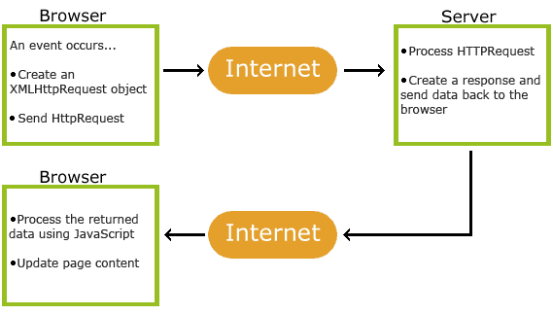
6. Introducing AJAX

Slide 44
XMLHttpRequest
Used to exchange data with the server
Object Initialization (IE7+, Firefox, Chrome, Safari, and Opera):
var xhr =new XMLHttpRequest();
For IE6 and earlier:
var xhr = new ActiveXObject("Microsoft.XMLHTTP");

Slide 45
Send request
Method | Description
open(method,url,async) | Specifies the type of request, the URL, and if the request should be handled asynchronously or not. method: the type of request: GET or POST url: the location of the file on the server async: true (asynchronous) or false (synchronous)
send(string) | Sends the request off to the server. string: Only used for POST requests
xhr.open("GET","ajax_info.xml",true);
xhr.send();

Slide 46
Get response
Property | Description
responseText | get the response data as a string
responseXML | get the response data as XML data
var xmlDoc = xhr.responseXML;
var result = document.getElementById("result");
result.innerHTML = xmlDoc.getElementsByTagName("title")[0].childNodes[0].nodeValue;

Slide 47
Check state
Property | Description
onreadystatechange | Stores a function (or the name of a function) to be called automatically each time the readyState property changes
readyState | Holds the status of the XMLHttpRequest. Changes from 0 to 4: 0: request not initialized 1: server connection established 2: request received 3: processing request 4: request finished and response is ready
status | 200: "OK" 404: Page not found

Slide 48
Check state
xhr.onreadystatechange=function()
{
if (xhr.readyState==4 && xhr.status==200)
{
//handling when loading data successfully
}
else
{
//handling when data can't be loaded
}
}

Slide 49
Some examples
Example 1: students.XML
Display the list of students saved in the xml file when loading the website
Student information:
id
name
birthday
gender
<students>
<student>
<id>456</id>
<name>Tom</name>
<birthday>1/1/1993</birthday>
<gender>Man</gender>
</student>
...
</students>
Define file name students.XML

Slide 50
Some examples
HTML list page
students.HTML
<body>
<button type="button" onclick="loadStudents()">Load Student</button>
<table border="1" style="width:100%">
<tr style="background-color:blue;color:white">
<th>Id</th>
<th>Name</th>
<th>Birthday</th>
<th>Gender</th>
</tr>
<tbody id="idbodytable">
</tbody>
</table>
</body>

Slide 51
Some examples
HTML list page
students.HTML
<head>
<meta charset="utf-8" />
<title></title>
<script type="text/javascript">
function loadStudents()
{
}
</script>
</head>

Slide 52
Some examples
students.HTML
function loadStudents(){
var xhr = new XMLHttpRequest();
xhr.open("GET", "students.xml", true);
xhr.send();
xhr.onreadystatechange=function(){
if (xhr.readyState==4 && xhr.status==200){
var xmlDoc = xhr.responseXML;
contacts = xmlDoc.getElementsByTagName("student")
bodytable = document.getElementById("idbodytable")
bodytable.innerHTML = ""
for (i = 0; i < contacts.length; i++){
id = contacts[i].getElementsByTagName("id")[0].childNodes[0].nodeValue
name = contacts[i].getElementsByTagName("name")[0].childNodes[0].nodeValue
birthday = contacts[i].getElementsByTagName("birthday")[0].childNodes[0].nodeValue
gender = contacts[i].getElementsByTagName("gender")[0].childNodes[0].nodeValue
tr = "<tr><td>" + id + "</td><td>" + name + "</td><td>" + birthday +"</td><td>"+gender+ "</td></tr>"
bodytable.innerHTML += tr
}
}
else{}
}
}

Slide 53
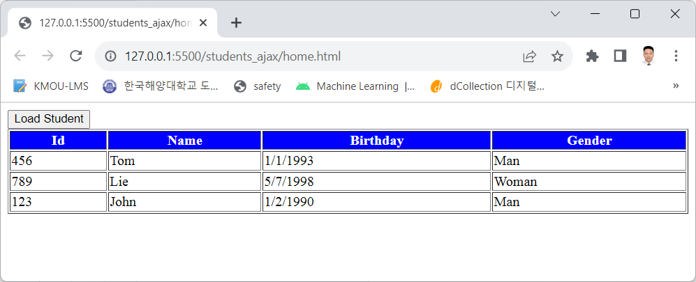
Some examples

Slide 54
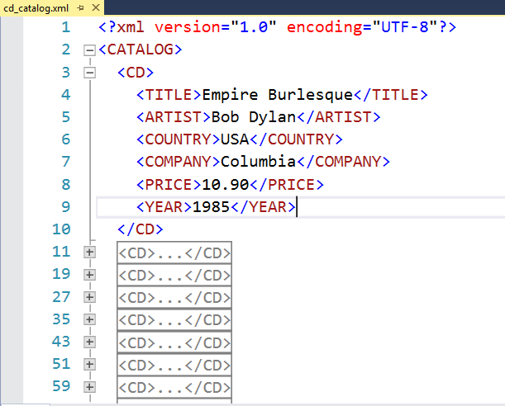
Some examples
Example 2: cd_catalog.xml on w3c
Double click on the icon, save this Xml file at the same level as the HTML file

Slide 55
Some examples
<!DOCTYPE html>
<html>
<style>
table, th, td {
border: 1px solid black;
border-collapse: collapse;
}
th, td {
padding: 5px;
}
</style>
ContactAJAX.html

Slide 56
Some examples
<body>
<h1>The XMLHttpRequest Object</h1>
<button type="button" onclick="loadDoc()">Get my CD collection</button>
<br><br>
<table id="demo"></table>
<script>
function loadDoc() {
var xhttp = new XMLHttpRequest();
xhttp.onreadystatechange = function() {
if (this.readyState == 4 && this.status == 200) {
myFunction(this);
}
};
xhttp.open("GET", "cd_catalog.xml", true);
xhttp.send();
}

Slide 57
Some examples
function myFunction(xml) {
var i;
var xmlDoc = xml.responseXML;
var table="<tr><th>Artist</th><th>Title</th></tr>";
var x = xmlDoc.getElementsByTagName("CD");
for (i = 0; i <x.length; i++) {
table += "<tr><td>" +
x[i].getElementsByTagName("ARTIST")[0].childNodes[0].nodeValue +
"</td><td>" +
x[i].getElementsByTagName("TITLE")[0].childNodes[0].nodeValue +
"</td></tr>";
}
document.getElementById("demo").innerHTML = table;
}
</script>
</body>
</html>

Slide 58
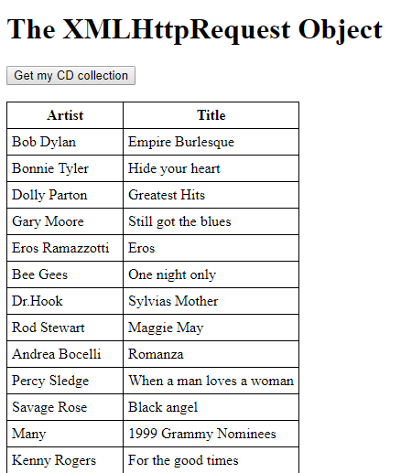
Some examples

Slide 59


Hey! Coding is easy!
END

